Slide 1


Visualizing Real World Data
Data Science Bootcamp 2020
Final Project

Slide 2
Real World Data Device data that is not from a clinical trial that is used to generate evidence for regulatory purposes
Notes:
Travel to the brain through the vasculature and treat strokes
Devices to treat stroke Clinical trial data
New to medical device company

Slide 3
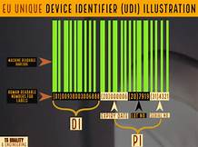
Strict new regulations in Europe No evidence No label no selling

Slide 4
Premier Health Database 2 TB of data
Features
Patients Devices
Targets
Retreatment, Stroke, Death
4M Stroke Patients
Unknown
1-year follow-up
Notes:
Data on medical devices or pharmaceuticals that is not collected as part of a study
Demographic and medical data from patient level file

Slide 5
Premier Health Database 2 TB of data
Features
Patients Devices
Targets
Retreatment, Stroke, Death
Notes:
Data on medical devices or pharmaceuticals that is not collected as part of a study
Demographic and medical data from patient level file

Slide 6
Premier Health Database 2 TB of data
Features
Patients Devices
Targets
Retreatment, Stroke, Death
Match the diagnosis and the surgery
Notes:
Data on medical devices or pharmaceuticals that is not collected as part of a study
Demographic and medical data from patient level file

Slide 7
Premier Health Database 2 TB of data
Features
Patients Devices
Targets
Retreatment, Stroke, Death
Match the diagnosis and the surgery
See what devices they were charged for
Notes:
Data on medical devices or pharmaceuticals that is not collected as part of a study
Demographic and medical data from patient level file

Slide 8
Premier Health Database 2 TB of data
Features
Patients Devices
Targets
Retreatment, Stroke, Death
Match the diagnosis and the surgery
See what devices they were charged for
Follow for a year for Safety and Effectiveness of Treatment
X diagnoses and procedures per year
4M stroke patients
148K procedures
1,466 microcatheters
Notes:
357K procedures for patients with the right dx

Slide 9
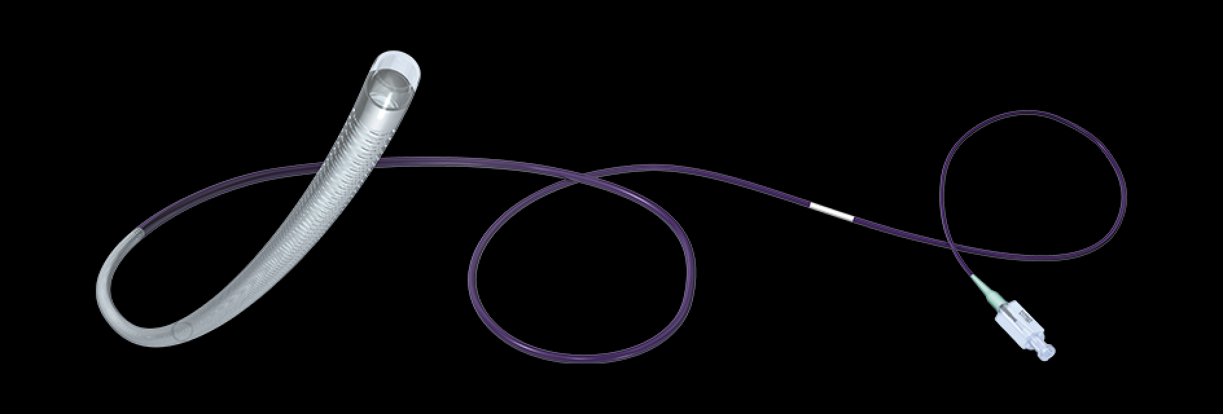
Can we find the data we need? Microcatheters
Notes:
Put company logos here

Slide 10
Strategy
Identify patients who were treated for stroke in 2017

Slide 11
Strategy
Identify patients who were treated for stroke in 2017
Identify devices in the hospital billing files for these patients

Slide 12

Identify patients who were treated for stroke in 2017
Identify devices in the hospital billing files for these patients
Pull one year of follow-up data on diagnoses and procedures

Slide 13
Identify patients who were treated for stroke in 2017
Identify devices in the hospital billing files for these patients
Pull one year of follow-up data on diagnoses and procedures

Slide 14
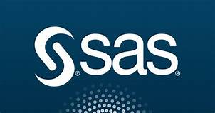



Tools

Slide 15

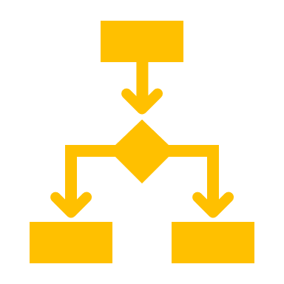


Supervised Machine Learning Model to identify devices
Search the hospital charge description for SKU numbers
Output a dataset with a flag variable for matching devices
Split the dataset into train and test datasets
Train and test the model
Logistic Regression

Slide 16
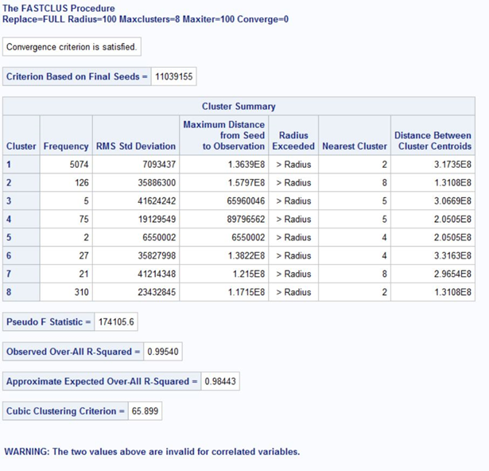
Supervised Machine Learning Model to identify devices
Logistic Regression Results
Too many false positives

Slide 17

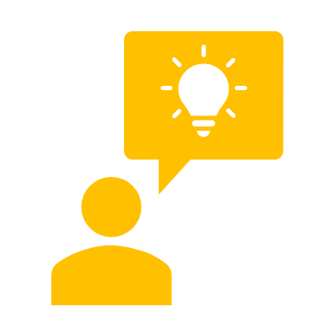
Other methods used to find targets
Identify devices using regular expressions in SAS
Select rows where the Standard Charge Description equals “Microcatheters”

Slide 18
Final method used to find targets
Select rows where the Standard Charge Description equals “Microcatheters”
Identify devices using regular expressions in SAS

Slide 19
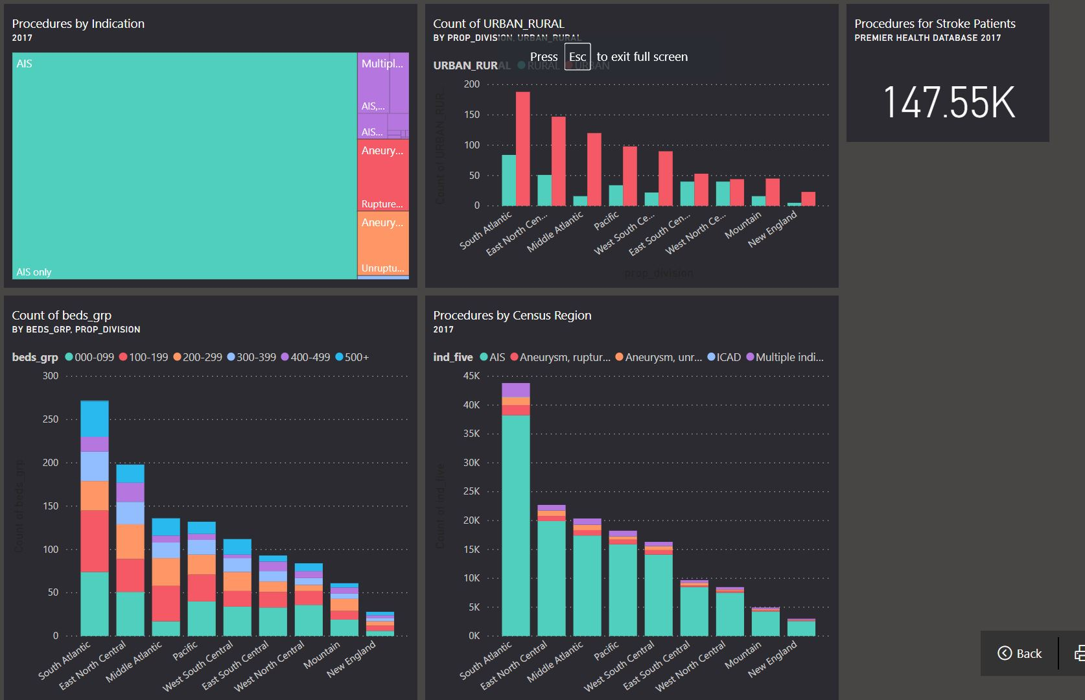

Slide 20
Notes:
Add in the counts by manufacturer

Slide 22


Then
Now
Ask a few surgeons if the device is working okay
Buy anonymized hospital data
Find data on our devices and competitors’ devices
Compare and report
Notes:
What ev
Compare our product to the competitionidence are we looking for in the data?

